Slide 1
Course Project Paper

Slide 2
INTRODUCTION
When planning for retirement, savings are crucial. A comfortable retirement is possible with careful planning of spending and saving. Individuals who have planned for their retirement are more likely to be able to maintain a high standard of living once they stop working.
Having a reliable source of income in retirement is a huge bonus for households. If people have a clear understanding of what they may expect, they may have an easier time deciding on a retirement savings and income strategy. Preventative approaches help consumers identify savings gaps, adjust savings plans, and make the most of retirement-related investment possibilities.
Planning for retirement expenses might give you financial independence and a sense of calm. It's crucial to prepare for retirement early on in order to guarantee a comfortable financial future in old life. Retirement could be a time of rest and discovery if one prepares for it properly. Careful planning and projection can lead to financial stability and happiness in retirement.

Slide 3
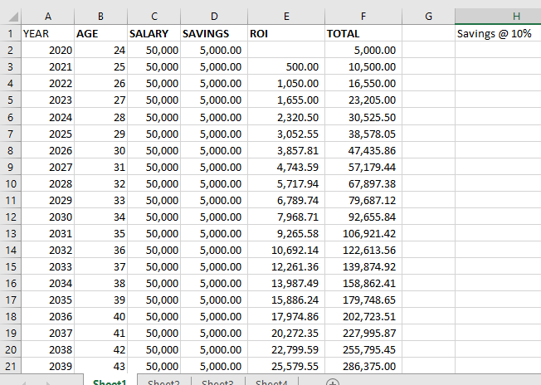
THE MODEL

Slide 4
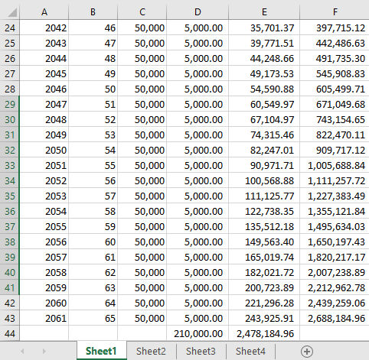

Slide 5
Explanation
Starting at age 24, the accompanying image shows a possible retirement planning timeline that extends through age 65. Using a person's initial salary, their savings rate, their expected return on investment (ROI), and the rate of inflation, the model estimates the latter's future wealth. The model uses an assumed savings rate of 10% to determine the possible funds at retirement age (65).

Slide 6
Reason for designing
Among the various factors monitored by the model over extended periods of time are the user's age, salary, savings, return on investment, and total savings. This time-dependent approach allows for a dynamic analysis of retirement savings over time by factoring in changing income, savings, and investment growth.
The retirement budget is updated once a year to reflect the impact of inflation on future costs. This aids in ensuring that the retirement fund can maintain the intended level of life into old age, even after inflation is taken into account.
Compound interest serves as a model for the growth of savings over time. The savings of the individual rise at an exponential rate as a result of the annual addition of the ROI.
The plan is based on the idea that a person will regularly set aside 10% of their annual salary for savings. Making this assumption makes it easier to evaluate the long-term impacts of a strategy and stick to a consistent savings plan.

Slide 7
The model assumes retirement at age 65, which is also a common retirement age. This allows for a reliable estimation of one's retirement nest egg and future retirement income.
The model's assumption of a constant yearly salary can be at odds with the reality, where pay often increases with seniority and competence. The simple prediction, however, can serve as a jumping-off point for retirement planning.
The emphasis on ROI reflects the model's interest in the growth of capital through investments in equities, fixed income, and other asset classes.
The idea rests on the assumption that the customer will not add any supplemental annual savings contributions. It's a fact that individuals can occasionally make irrational decisions.

Slide 8
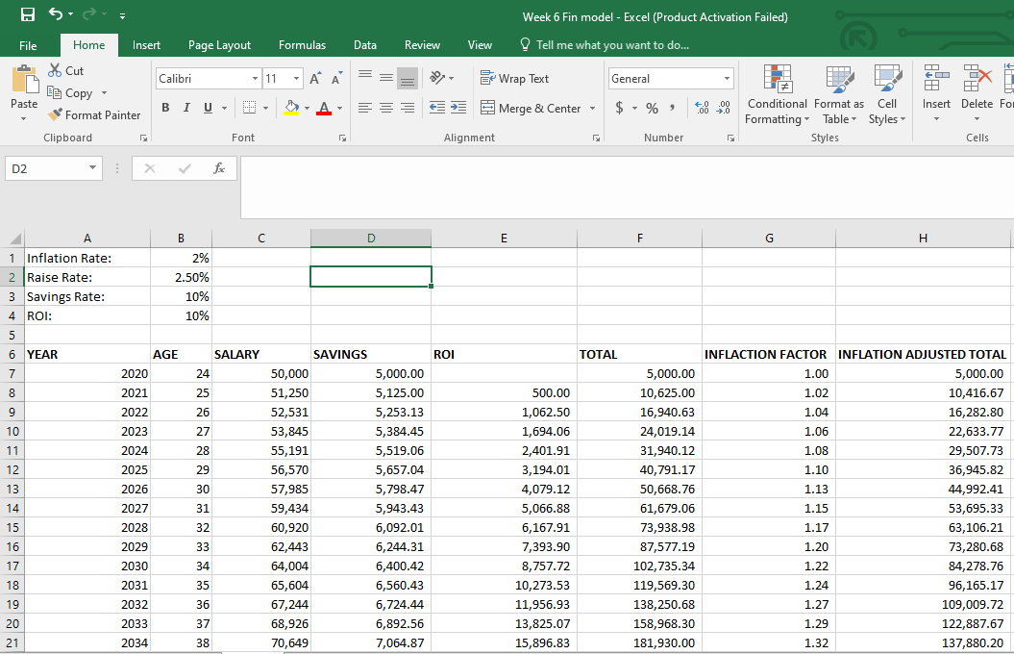

Slide 9
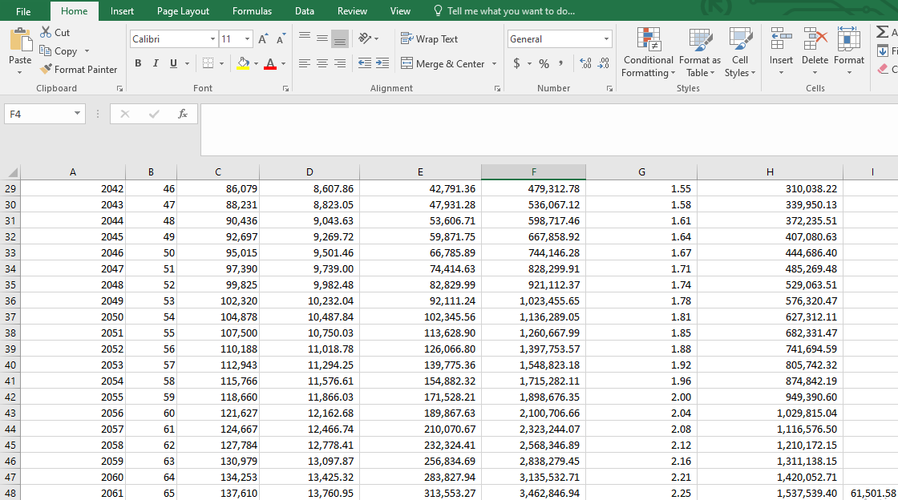

Slide 10
With inflation and wage growth rates accounted for, the provided model provides a more accurate estimate of retirement savings. The model tracks the saver's progress through time, factoring in inflation and return on investment (ROI).
The New and Improved Model Defined
There will be no change to the current annual inflation rate of 2%. When inflation raises prices across the board, consumers have less purchasing power because of their currency.
The rate of increase is 2.50 percent per year. Over the course of a career, this is the typical annual salary increase one can expect for a certain individual.
Ten percent a year, or ten percent of the worker's annual salary, is set aside for savings, and ten percent a year is invested at a fixed rate of return.
The program will keep applying an inflation factor to the savings as time goes on to reflect the real cost of living.

Slide 11
Reason for Updating the Model
Inflation is a major factor in explaining why your retirement savings won't go as far as they did when you were working. The new model gives a more accurate estimate of the future worth of savings by factoring in the impact of inflation on costs.
Future salary rises can be predicted by adding the individual's anticipated annual raise rate to the model. The amount of money a person has saved for retirement depends directly on their capacity to put away a larger portion of their income each year.
The 10% ROI is speculative, but it is a plausible projection. The value of an investment could go up or down depending on market conditions.
Retirement Planning Tactics: By considering inflation, wage growth, and ongoing savings, the updated model produces a more comprehensive and precise prediction of retirement funds. As people approach retirement age, this could help them make more informed decisions.
In sum, the updated model takes into account key financial factors that may have a significant impact on retirement savings. It gives a more realistic picture of how the person's finances may change over time by factoring in both positive (raise rate, ROI) and negative (inflation) financial variables. Reviewing and adjusting the model on a frequent basis to reflect actual financial situations and market conditions is vital for any retirement estimate. Additionally, you may gain new insight and retirement planning strategies by speaking with a financial counselor.

Slide 12
Case questions for Bob
Bob Davidson, a marketing professor at age 46, is getting ready to retire. His family consists of himself, his wife Margaret, and their 6-year-old daughter Sue. For the first nine months of the year, Bob is paid $95,000, and the institution also provides him with an additional $10,000 in retirement benefits. He earns extra money by consulting, helping with research, and other side jobs.
Bob uses TIAA-CREF as his investment vehicle, and in addition to the school's contribution, he sets aside $7,500 year for his retirement. His retirement savings total $137,000, with a portion invested in the TIAA Long Term Bond Fund and the rest in the TIAA Global Equity Fund. In addition to his home, emergency funds, and investments for his daughter's education, Bob also has a $580,000 term life insurance policy.

Slide 13
Beyond his retirement assets, Bob has $40,000 in home equity, $50,000 in savings, and $24,000 in a Fidelity Growth and Income Fund for his daughter's schooling. He has no outstanding debt and a $580,000 term life insurance policy.

Slide 14
Will the amount he is accumulating at his current rate of savings be adequate?
Up to 15 years into retirement, it would be sufficient.
How much should he be setting aside each year? Approx. 7, 80,000
How much will he have to live on when he retires? How long after retirement will he be able to live comfortably?
Till 81 year age he has no problem of fund deficiency.

Slide 15
What are the risks he faces, and how should his retirement planning take these risks into account?
Factors that may affect your life expectancy include: the economy, inflation, healthcare, social security, education expenditures, the value of your estate, and your family's medical history.

Slide 16
Conclusion
To ensure financial security and contentment in one's elder years, retirement planning is a major undertaking that calls for careful consideration and foresight. At age 46, marketing professor Bob Davidson illustrates why it's never too early to start saving for retirement. Bob hopes to keep working until he's 60 or 65, at which point he'll retire and spend his time exploring the world.
It's important to remember that saving for retirement isn't a one-and-done task. Retirees like Bob can face the future with confidence and security if they seek advice from specialists and stay up with the rapidly evolving financial landscape. The golden years of retirement can be stress-free if people save carefully and intelligently in advance.

Slide 17
Would I buy stock in the company I selected? Why or why not?
Before deciding to invest in a company, many potential buyers conduct extensive analysis of the company's financial standing, track record, industry trends, position relative to competitors, and potential for future growth.
Keep in mind that the price of any stock you purchase could go up or down based on a number of factors, including the mood of the market and the state of the economy as a whole. Common methods of diversifying holdings across a number of companies include mutual funds and exchange-traded funds (ETFs).
Make sure the investment you're contemplating is in line with your goals, level of risk tolerance, and time horizon by consulting a financial adviser or doing your own research.

Slide 18
References
Taylor, M. A., & Doverspike, D. (2003). Retirement planning and preparation. Retirement: Reasons, processes, and results, 53-82.
Merton, R. C. (2014). The crisis in retirement planning. Harvard Business Review, 92(7/8), 43-50.
Elder, H. W., & Rudolph, P. M. (1999). Does retirement planning affect the level of retirement satisfaction?. Financial Services Review, 8(2), 117-127.
Petkoska, J., & Earl, J. K. (2009). Understanding the influence of demographic and psychological variables on retirement planning. Psychology and aging, 24(1), 245.

